Slide 1


Chapter 2
Point-to-Point Protocol
(PPP)
Part II

Slide 2
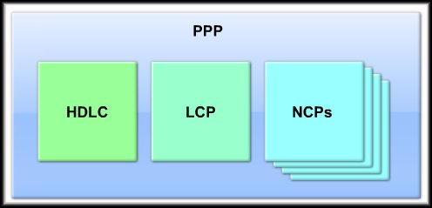
Point-to-Point Protocol (PPP)
PPP Concepts

Slide 3
Introducing PPP
What is PPP?
  Recall that HDLC is the default serial encapsulation method when you connect two Cisco routers.
  Cisco HDLC can only work with other Cisco devices.
  When you need to connect to a non-Cisco router, you should use PPP encapsulation.
    PPP includes many features not available in HDLC.
    The link quality management feature monitors the quality of the link. If too many errors are detected, PPP takes the link down.
    PPP supports PAP and CHAP authentication.

Slide 4
Introducing PPP
What is PPP?
  Three main components:
  HDLC:
    HDLC protocol for
    encapsulating datagrams over point-to-point links.
  LCP:
    Extensible Link Control Protocol (LCP) to establish, configure, and test the data link connection.
  NCPs:
    Family of Network Control Protocols (NCPs) for establishing and configuring different network layer protocols.

Slide 5
Introducing PPP
What is PPP?
  Three main components:
  HDLC:
    HDLC protocol for
    encapsulating datagrams over point-to-point links.
  LCP:
    Extensible Link Control Protocol (LCP) to establish, configure, and test the data link connection.
  NCPs:
    Family of Network Control Protocols (NCPs) for establishing and configuring different network layer protocols.

Slide 6
PPP Layered Architecture
IP
IPX
Many Others
Network Layer
Network Control Protocol (NCP)
Point-to-Point Protocol
(PPP)
Data Link Layer
Link Control Protocol (LCP)
Synchronous or Asynchronous
Physical Medium
Physical Layer
PPP is a Data Link Layer protocol that provides a standard method for transporting multiprotocol datagrams over point-to-point links.
Translation: IP and IPX and others, simultaneously, over a single dialup or higher speed WAN link.

Slide 7
PPP Layered Architecture
IP
IPX
Many Others
Network Layer
Network Control Protocols (NCPs)
Data Link Layer
Link Control Protocol (LCP)
Synchronous or Asynchronous
Physical Medium
Physical Layer
PPP has a layered architecture:
  Link Control Protocol (LCP): To establish, configure and test the connection.
  Network Control Protocols (NCPs): A family of protocols to establish and configure Network Layer protocols.

Slide 8
PPP Layered Architecture
IP
IPX
Many Others
Network Layer
Network Control Protocols (NCPs)
Data Link Layer
Link Control Protocol (LCP)
Synchronous or Asynchronous
Physical Medium
Physical Layer
PPP can be configured on multiple types of interfaces:
  Asynchronous serial
  Synchronous serial
  High-Speed Serial Interface (HSSI)
  Integrated Services Digital Network (ISDN)

Slide 9
PPP Layered Architecture
IP
IPX
Many Others
Network Layer
Network Control Protocols (NCPs)
Data Link Layer
Link Control Protocol (LCP)
Synchronous or Asynchronous
Physical Medium
Physical Layer
PPP uses the Link Control Protocol (LCP) to negotiate and setup control options on the WAN link.
  Authentication, Compression, Error Detection, Multilink for load balancing, PPP Callback and link monitoring functions.

Slide 10
PPP Callback
PPP callback serves two purposes:
It controls access between routers by requiring user authentication and verification, and it allows companies to control costs between routers. This permits salespeople on the road to call securely from different physical locations.
Also, the PPP callback system enables employers to pick up the toll phone costs of system administrators who work remotely.
For PPP callback to operate, two routers must establish a PPP link and have link control protocol, or LCP, enabled. LCP negotiates user authentication options.
One router must be designated the "client," while the other acts as the "server." The system administrator configures the client to initiate PPP callback requests and sets the server to accept callback requests and place calls. The system administrator also selects the compression, identification and network layer protocols that will be used in the callback process

Slide 11
PPP Layered Architecture
IP
IPX
Many Others
Network Layer
Network Control Protocols (NCPs)
Data Link Layer
Link Control Protocol (LCP)
Synchronous or Asynchronous
Physical Medium
Physical Layer
PPP uses the Network Control Protocols (NCPs) to permit multiple network layer protocols to operate on the same communications link.

Slide 12
PPP Layered Architecture
IP
IPX
Many Others
Network Layer
IPCP
IPXCP
Many Others
Data Link Layer
Link Control Protocol (LCP)
Synchronous or Asynchronous
Physical Medium
Physical Layer
For every network layer protocol used, a separate Network Control Protocol (NCP) is provided.
  NCPs include functional fields containing standardized codes to indicate the network layer protocol type that PPP encapsulates.

Slide 13
FYI - PPP Protocol Suite
Application
Presentation
PPP Over Ethernet
Control Protocols
Session
Multilink
Transport
Network
Multiple Network Protocols
Data Link
Link Protocols
BAP, CHAP, EAP,
LCP, LEX, LQR,
PAP
ATCP ECP NBFCP
BCP IPCP OSINLCP
BACP IPv6CP SDCP
CCP IPXCP SNACP
DNCP LEXCP
PPPoE
MLP
Remote
Bridges
PPP-BPDU
PPP
Physical
LAN / WAN

Slide 14
FYI - PPP Protocol Suite
PPP-BPDU: PPP Bridge Protocol Data Unit
There exist two basic types of bridges: those that interconnect LANs directly, called Local Bridges, and those that interconnect LANs via an intermediate WAN medium such as a leased line, called Remote Bridges. The PPP-BPDU (Bridge Protocol Data Unit) is used to connect Remote Bridges.
MLP: Multilink PPP is a communications protocol that enables a personal computer (PC) to use two PPP(Point-to-Point Protocol) communications ports as if they were a single port of greater bandwidth.
PPPoE: PPP, which was designed for serial communications, has now been adapted to Ethernet, and is appropriately called PPP over Ethernet (PPPoE). Serial ISPs already use PPP over modem communications. DSL providers on the other hand use Ethernet, not serial communications. Because of this, many require the added functionality of PPP over Ethernet.

Slide 15
Link Protocols:
Link Protocols:
  BAP: Bandwidth Allocation Protocol
  CHAP: Challenge Handshake Authentication Protocol
  EAP: Extensible Authentication Protocol
  LCP: Link Control Protocol
  LEX: LAN Extension Interface Protocol
  LQR: Link Quality Report
  PAP: Password Authentication Protocol

Slide 16
FYI - PPP Protocol Suite
Control Protocols:
  ATCP: AppleTalk Control Protocol
  BACP: Bandwidth Allocation Control Protocol
  BCP: Bridging Control Protocol
  CCP: Compression Control Protocol
  DNCP: DECNet Phase IV Control Protocol
  ECP: Encryption Control Protocol
  IPCP: IP Control Protocol
  IPv6CP: IPv6 Control Protocol
  IPXCP: Novell IPX Control Protocol
  LEXCP: LAN Extension Interface Control Protocol

Slide 17
FYI - PPP Protocol Suite
Control Protocols:
  NBFCP: NETBIOS Frames Control Protocol
  OSINLCP: OSI Network Layer Control Protocol
  SDCP: Serial Data Control Protocol
  SNACP: Systems Network Architecture Control Protocol

Slide 18
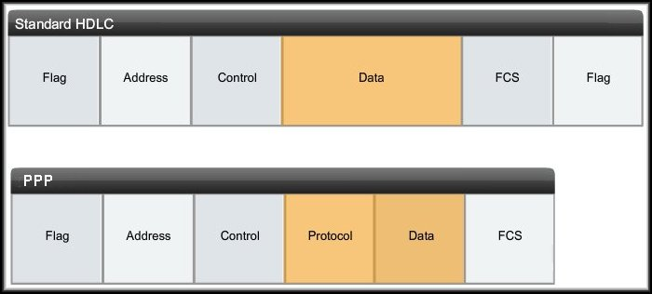
PPP Frame Structure
Notice how the PPP frame has been modeled very closely on the standard HDLC frame.
The protocol field contains specific codes.

Slide 19
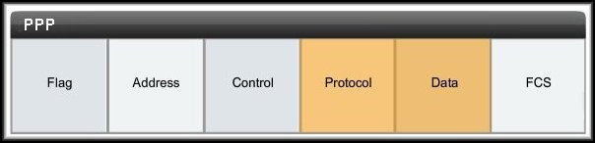
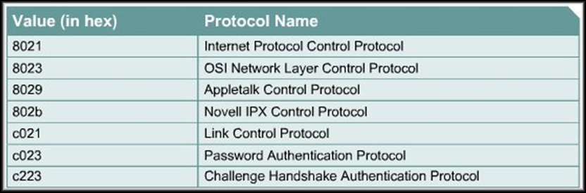
FYI - PPP Frame Structure
Some of those codes:

Slide 20
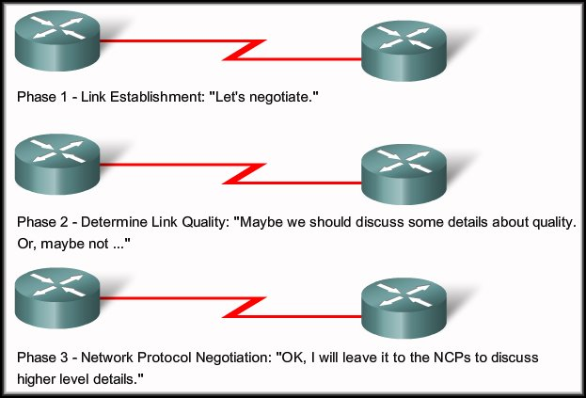
Establishing a PPP Session
PPP session establishment progresses through
Three Phases.

Slide 21
Establishing a PPP Session
Phase 1 – Link Establishment:
  The LCP must first open the connection and negotiate configuration options.
Phase 2 – Determine Link Quality (Optional):
  The LCP tests the link to determine whether the link quality is sufficient to bring up network layer protocols.
Phase 3 – Network Protocol Negotiation:
  The appropriate NCP separately configures the network layer protocols.
  The NCP can bring them up and take them down at any time.

Slide 22
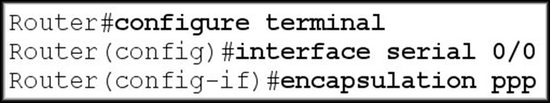
Establishing a Link with LCP
Phase 1 – Link Establishment:
  In this phase each PPP device sends LCP frames to configure and test the data link.
  LCP frames contain a configuration option field that allows devices to negotiate the use of options such as:
    The maximum transmission unit (MTU)
    Compression of certain PPP fields
    The link-authentication protocol.

Slide 23
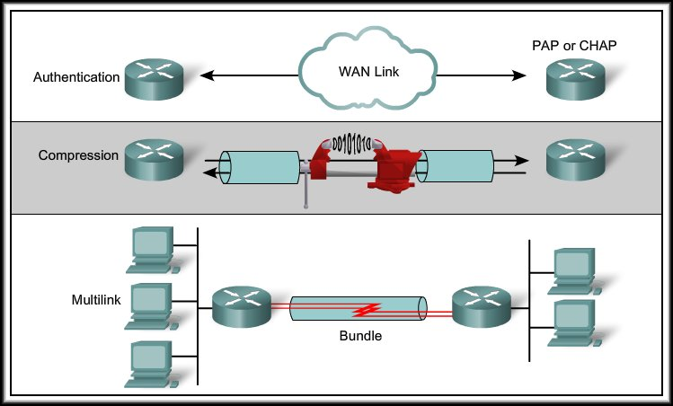
Establishing a Link with LCP
If a configuration
option is not
included in an LCP
packet, the default
value is assumed.
Before any network layer packets can be exchanged, LCP must first open the connection and negotiate the configuration parameters.
This phase is complete when a configuration acknowledgment frame has been sent and received.

Slide 24
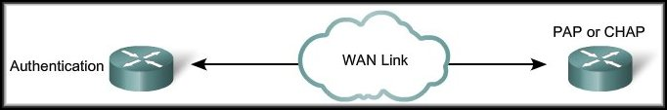
Establishing a Link with LCP
Authentication:
  After the link has been established and the authentication protocol decided on, the peer may be authenticated.
  Authentication, if used, takes place before the network layer protocol phase is entered.

Slide 25
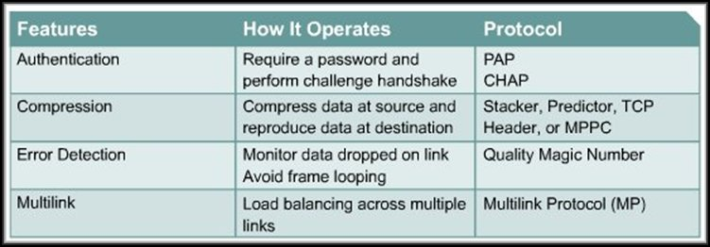
Establishing a Link with LCP
As part of this phase, LCP also allows for an optional link-quality determination test.
  The link is tested to determine whether the link quality is good enough to bring up network layer protocols.
  PPP detects looped links using a feature involving magic numbers. When the node sends PPP LCP messages, these messages may include a magic number. If a line is looped, the node receives an LCP message with its own magic number, instead of getting a message with the peer's magic number.

Slide 26
Establishing a Link with LCP
LCP operation uses three classes of LCP frames to accomplish the work of each of the LCP phases:
  Link-establishment frames establish and configure a link (Configure-Request, Configure-Ack, Configure-Nak, and Configure-Reject)
    During link establishment, the LCP opens the connection and negotiates the configuration parameters.
    The Configure-Request frame includes a variable number of configuration options needed to set up on the link.
  Link-maintenance frames manage and debug a link (Code-Reject, Protocol-Reject, Echo-Request, Echo-Reply, and Discard-Request)
    Echo-Request, Echo-Reply, and Discard-Request - These frames can be used for testing the link.
  Link-termination frames terminate a link (Terminate-Request and Terminate-Ack)
    The link remains open until the LCP terminates it. If the LCP terminates the link before the NCP, the NCP session is also terminated.
    The device initiating the shutdown sends a Terminate-Request message. The other device replies with a Terminate-Ack.
Notes:
Use graphic 1.1.1.1
Use graphic 1.1.1.3

Slide 27
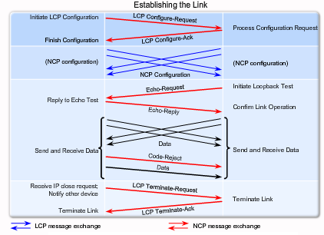
LCP Establishment

Slide 28
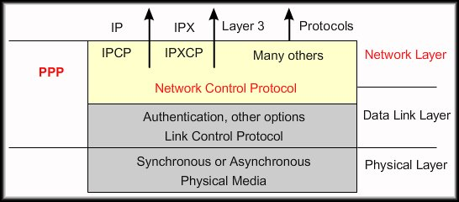
Network Layer Protocol Negotiation
PPP permits multiple Network layer protocols to operate on the same communications link.
  For every Network layer protocol used, PPP uses a separate NCP module.
    IP uses the IPCP module.
    IP Version 6 uses the IPv6CP module.
    IPX uses the IPXCP module.

Slide 29
Network Layer Protocol Negotiation
In this phase the PPP devices send NCP packets to choose and configure one or more network layer protocols (e.g. IP).
Once each of the chosen network layer protocols has been configured, packets from each network layer protocol can be sent over the link.
If LCP closes the link, it informs the network layer protocols so that they can take appropriate action.

Slide 30
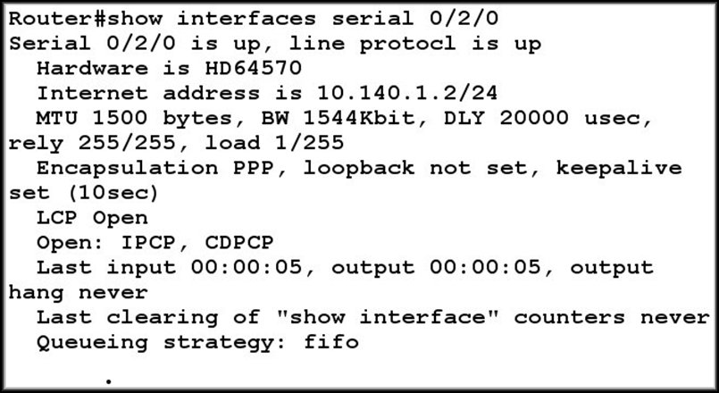
Network Layer Protocol Negotiation
LCP open = connection made.
NCPs
The show interfaces command reveals the LCP and NCP states under PPP configuration.

Slide 31
PPP Configuration Commands
Enabling PPP:
  Router#config t
  Router(config)#interface s0/2/0
  Router(config-if)#encapsulation ppp
Configuring Compression:
  You can configure point-to-point compression on serial interfaces after you have enabled PPP. Because this option invokes a software compression process, it can affect system performance. If the traffic already consists of compressed files (.zip, .tar, or .mpeg, for example), do not use this option.
  Router(config-if)#compress [predictor|stac]

Slide 32
PPP Configuration Commands
Link Quality Monitoring:
  LCP provides an optional link quality determination during the LCP Negotiation.
  If the link quality percentage is not maintained, the link is deemed to be of poor quality and is taken down.
  Router(config-if)#ppp quality percentage
Load Balancing Across Links:
  Multilink PPP (also referred to as MP, MPPP, MLP, or Multilink) provides a method for spreading traffic across multiple physical WAN links.
  Router(config-if)#ppp multilink

Slide 33
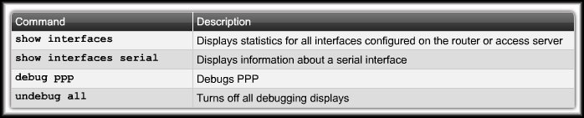
Verifying a Serial PPP Configuration
Use the show interfaces serial command to verify proper configuration PPP encapsulation.
  When you configure PPP, the output of the show interfaces serial command should show "encapsulation ppp".
  When you configure PPP, you can check its LCP and NCP states.

Slide 34
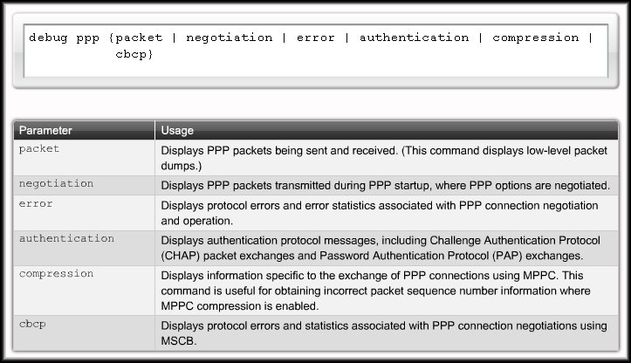
Troubleshooting PPP Encapsulation

Slide 35
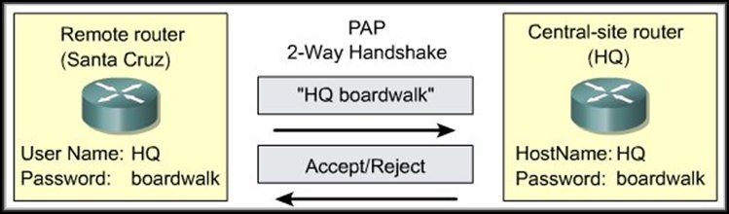
Point-to-Point Protocol (PPP)
PPP Authentication

Slide 36
PPP Authentication Protocol - PAP
Password Authentication Protocol (PAP):
  Not a strong protocol.
  Username/Password sent in clear text.
  Uses a two-way handshake.
  Remote node in control of attempts.
    Username/Password pair are repeatedly sent across the link until authentication is acknowledged or the link is terminated.

Slide 37
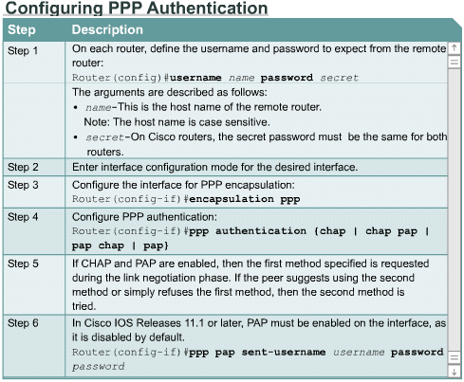
Configuring Authentication

Slide 38
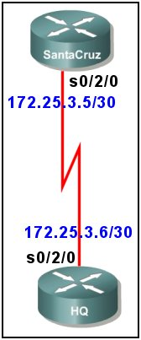
Remote usernames and passwords
PAP
hostname SantaCruz
username HQ password HQpass
interface serial 0/2/0
ip address 172.25.3.5 255.255.255.252
encapsulation ppp
ppp authentication pap
ppp pap sent-username SantaCruz password SantaCruzpass
hostname HQ
username SantaCruz password SantaCruzpass
interface serial 0/2/0
ip address 172.25.3.6 255.255.255.252
encapsulation ppp
ppp authentication pap
ppp pap sent-username HQ
password HQpass
Local usernames and passwords

Slide 39
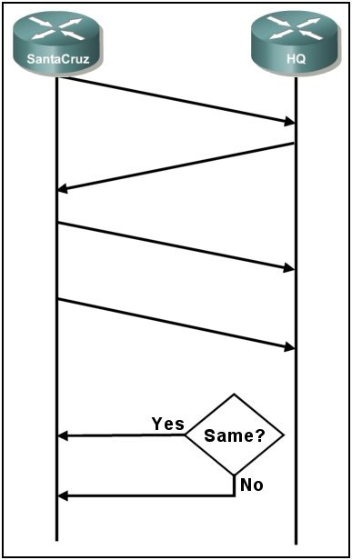
1. Establish PPP Link
2. Configuration request for PAP
authentication.
1
3. Configuration ACK.
2
4. SantaCruz sends the
SantaCruz username and
SantCruzpass password
configured for the interface.
3
5. HQ looks up the received name,
retrieves the password and
compares configured to received.
4
ACK
5
6. If they are the same, send an
ACK and allow access.
If they are not the same, send a
NACK and terminate the
connection.
6
NACK

Slide 40
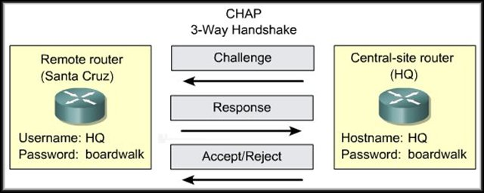
PPP Authentication Protocol - CHAP
Challenge Handshake Authentication Protocol (CHAP):
  The preferred authentication protocol.
  Uses a three-way handshake.
  Challenge/Response messages use MD5 hashing on random values and the password.
  Challenge/Response sequence repeated at random periods during the connect.

Slide 41
PPP Authentication Protocol - CHAP
CHAP provides protection against playback attack through the use of a variable and hashed challenge value that is unique and unpredictable.
The use of repeated challenges is intended to limit the time of exposure to any single attack.
Unlike PAP, the local router or a third-party authentication server is in control of the frequency and timing of the challenges.

Slide 42
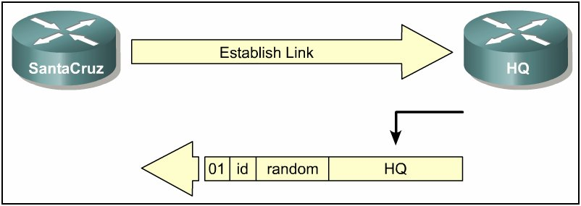
PPP Authentication – CHAP Challenge
SantaCruz calls HQ and establishes a ppp link.
A CHAP challenge packet is built by the HQ router with the following characteristics:
  01 = challenge packet type identifier.
  ID = sequential number that identifies the challenge.
  random = a reasonably random number generated by the router.
  HQ = the authentication name of the challenger.

Slide 43
CHAP Challenge
The ID and random values are kept on the HQ router or the called router.
The challenge packet is sent to the calling router.
A list of outstanding challenges is maintained.

Slide 44
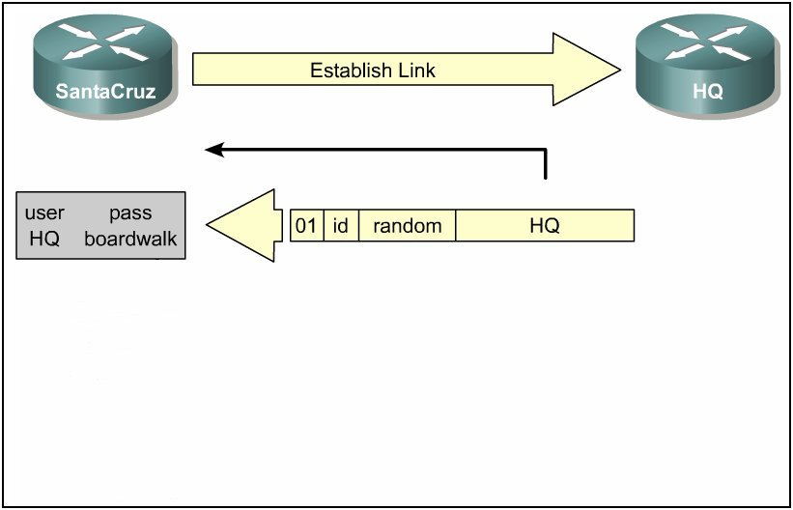
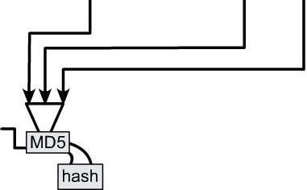
CHAP Challenge
Receive
CHAP
Challenge
The name HQ is used to look up the password.
The ID value, the random value and the password are fed into the MD5 hash generator.
The result is the one-way MD5-hashed CHAP challenge that will be sent back in the CHAP response.

Slide 45
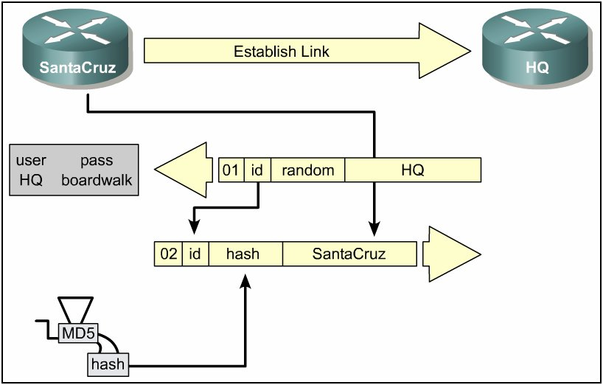
CHAP Challenge
CHAP
Response
The response packet is assembled and sent.
  02 = CHAP response packet type identifier.
  ID = copied from the challenge packet.
  hash = the output from the MD5 hash generator.
  SantaCruz = the hostname of the responding device.
  (From the hostname command or the
  ppp chap hostname command).

Slide 46
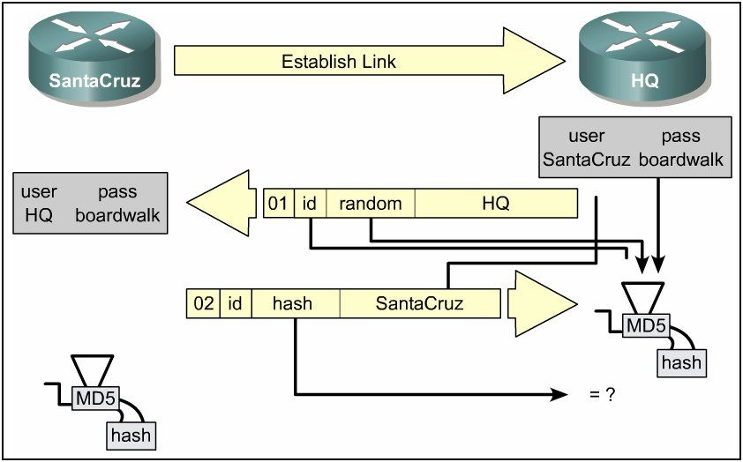
CHAP Challenge
Receive
CHAP
Response
The ID is used to find the original challenge packet.
The name is used to look up the password from a configured name or a security server.
The original ID, the original random value and the password are fed into the MD5 hash generator.

Slide 47
CHAP Challenge
Receive
CHAP
Response
The hash value received in the response packet is then compared to the calculated MD5 hash value.
CHAP authentication succeeds if the calculated and the received hash values are equal.

Slide 48
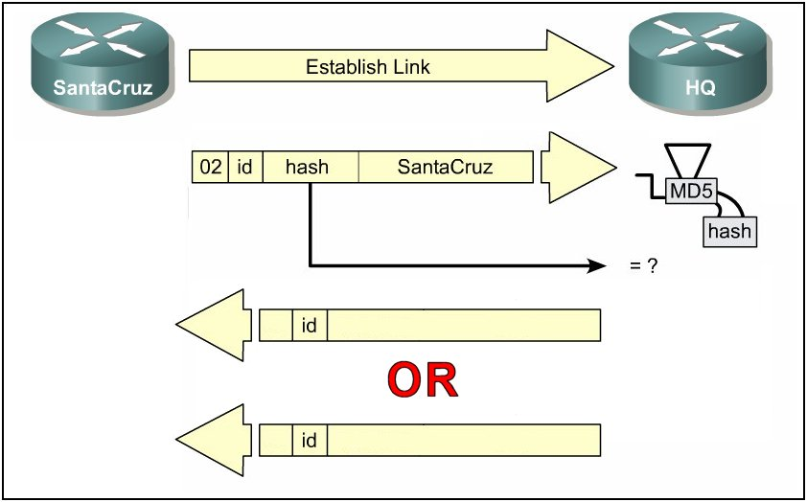
CHAP Challenge
Success
OR
Failure
03
Welcome In
If authentication is successful, a CHAP success packet is built from the following components:
  03 = CHAP success message type.
  ID = copied from the response packet.
  “Welcome In” is simply a text message providing a user-readable explanation.

Slide 49
CHAP Challenge
Success
OR
Failure
Welcome In
03
Welcome In
03
Authentication Failed
04
If authentication fails, a CHAP failure packet is built from the following components:
  04 = CHAP failure message type.
  ID = copied from the response packet.
  “Authentication failure” or other text message, providing a user-readable explanation.

Slide 50
PPP Configuration Command Summary
Router(config)#username name password password
Router(config)#interface serial 0/2/0
Router(config-if)#ip address address subnetmask
Router(config-if)#encapsulation ppp
Router(config-if)#ppp authentication chap
OR
Router(config-if)#ppp authentication pap
Router(config-if)#ppp pap sent-username name password password

Slide 51
debug ppp Command Summary
debug ppp argument
  debug ppp authentication
      Display the authentication exchange sequence.
  debug ppp chap
      Display CHAP packet exchanges.
  debug ppp error
      Display protocol errors and error statistics.
  debug ppp negotiation
      Display packets during connection establishment.
  debug ppp packet
      Display packets being sent and received.

